Slide 1

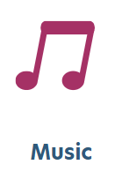
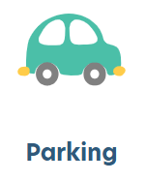



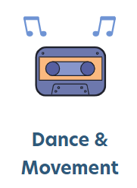



[Now Enrolling]
[Program Name]
at Busy Bees [Location]
Headline
We are now accepting registrations for our [Program Name]. Designed for curious learners, our program supports early growth through play-based learning, introducing literacy, math, science, and creative expression while building confidence and social skills.
(Delete icons that do not apply, adjust and delete this text.)
Contact us today to learn about
the Busy Bees difference!
[Address], [State/Province]
Open X:XX AM to X:XX PM
Call [Enrollment Number] to Enroll

