Slide 1
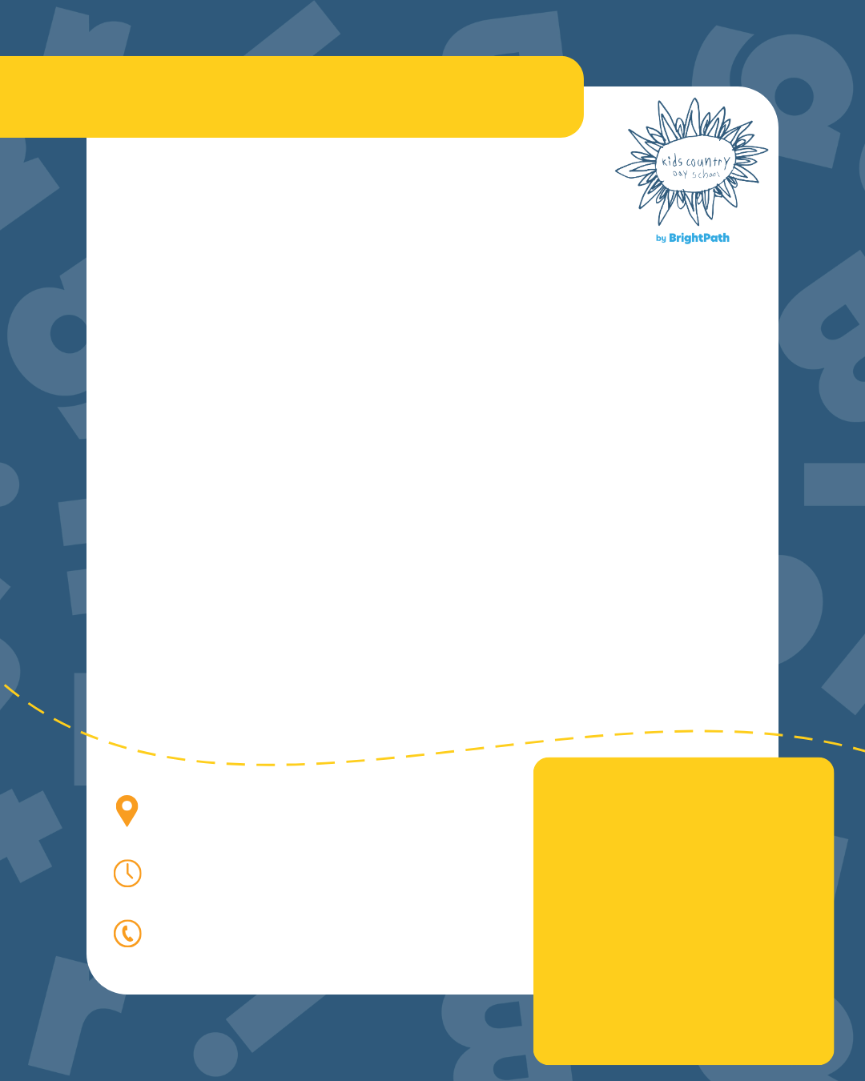

Now Enrolling
[Program Name]
at Kids Country by BrightPath [Location Name]
Headline
We are now accepting registrations for our [Program Name]. Designed for curious learners, our program supports early growth through play-based learning, introducing literacy, math, science, and creative expression while building confidence and social skills.
Contact us today to learn about
the Kids Country by BrightPath difference!
[Address], [State/Province]
Open X:XX AM to X:XX PM
Call [Enrollment Number] to Enroll

