Slide 1
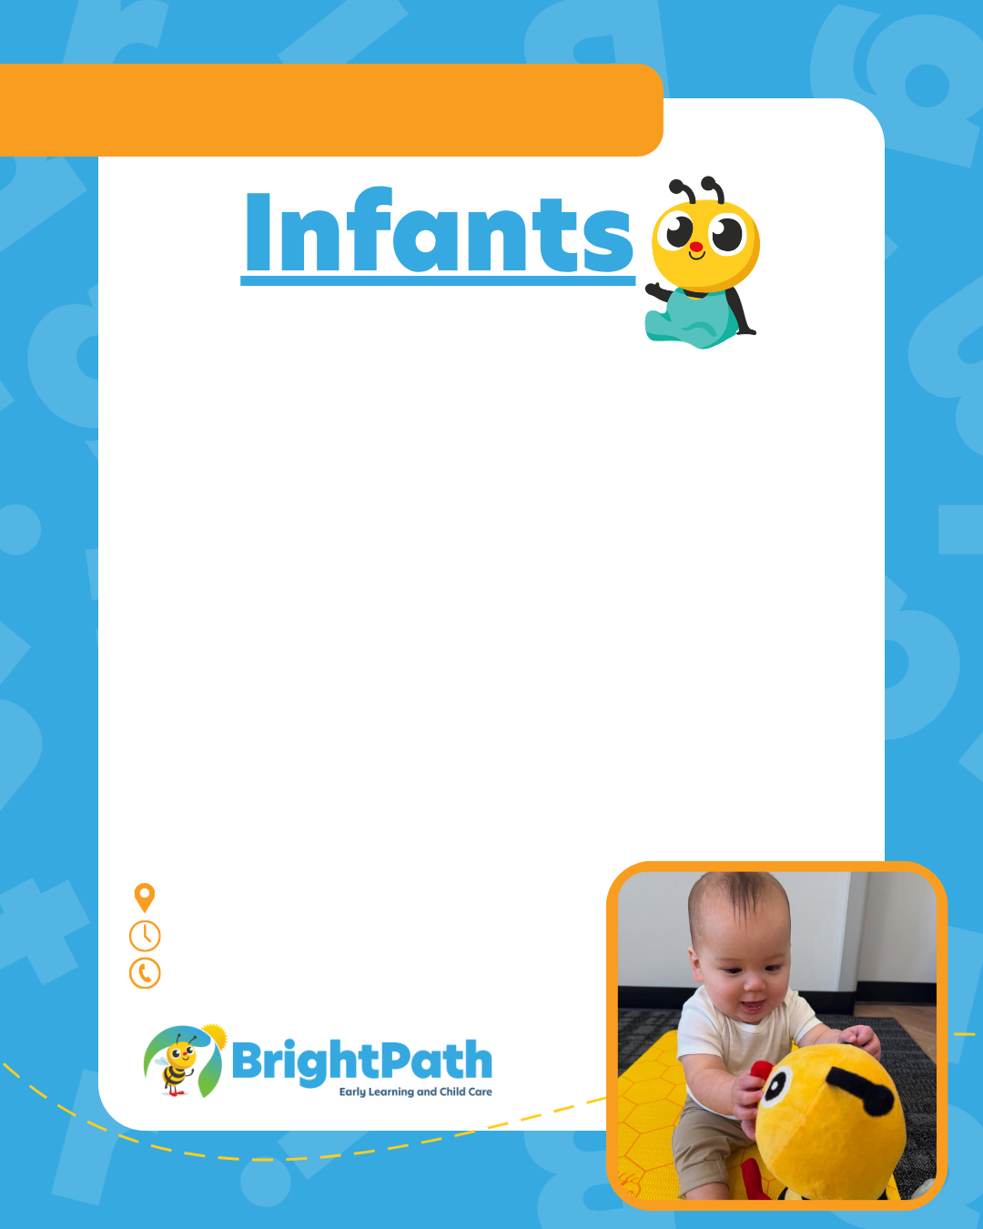

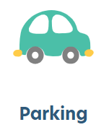






[Now Enrolling]
at BrightPath [Location]
Because Your Baby’s First School Matters.
At BrightPath [location name] Early Learning & Child Care, we proudly offer nurturing infant care beginning at 6 weeks old, along with other programs through [program name].
Our caring educators create a safe, responsive, and play-based environment supporting your baby’s development and giving families the best start in life.
Delete icons that do not apply, adjust and delete this text.
[Address], [State/Province]
Open X:XX AM to X:XX PM
Call [Enrollment Number] to Enroll

