Slide 1
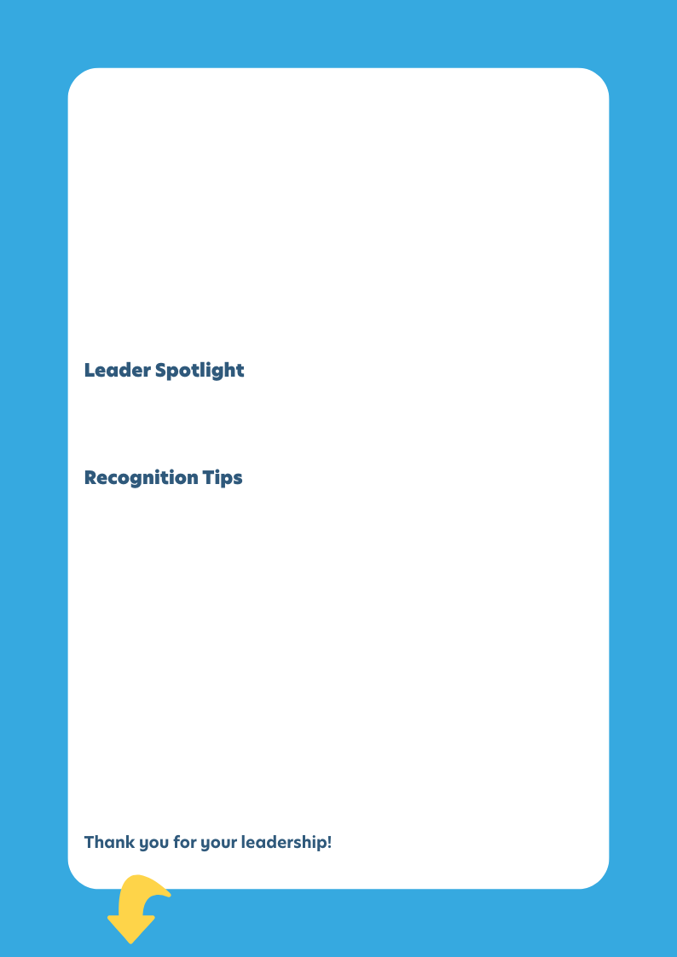

[Month] Reminder!
[Subheading]
[Body]
[First/Last Name]
[Title]
[Centre/er Name, State/Province]
[Subheading]
[Body]
[Subheading]
[Body]

Slide 2
Instructions
How to Add or Change a Headshot Inside a Circle in PowerPoint
Step-by-step:
1. Click on the circle shape
Make sure you’ve selected the circle where the photo should appear.
2. Go to the Shape Format tab at the top of the screen.
(If you don’t see it, make sure the shape is selected.)
3. Click the Shape Fill dropdown arrow. Inside ‘Shape Styles’, top right.
4. Choose Picture…
  A window will pop up with options to select your image.
5. In the pop-up window, select From a File…
6. Find your image on your desktop:
  In the file browser that appears, click Desktop on the left side.
  Locate your headshot image file.
  Click it once, then click Insert.
7. Your headshot will now appear inside the circle.
PowerPoint automatically fits the image inside the shape.
8. Adjust the image if needed:
  Right-click the circle → select Format Shape.
  In the sidebar, open Fill → Picture or texture fill.
  Use the Offset options (Top, Bottom, Left, Right) to reposition the face.

