Slide 1
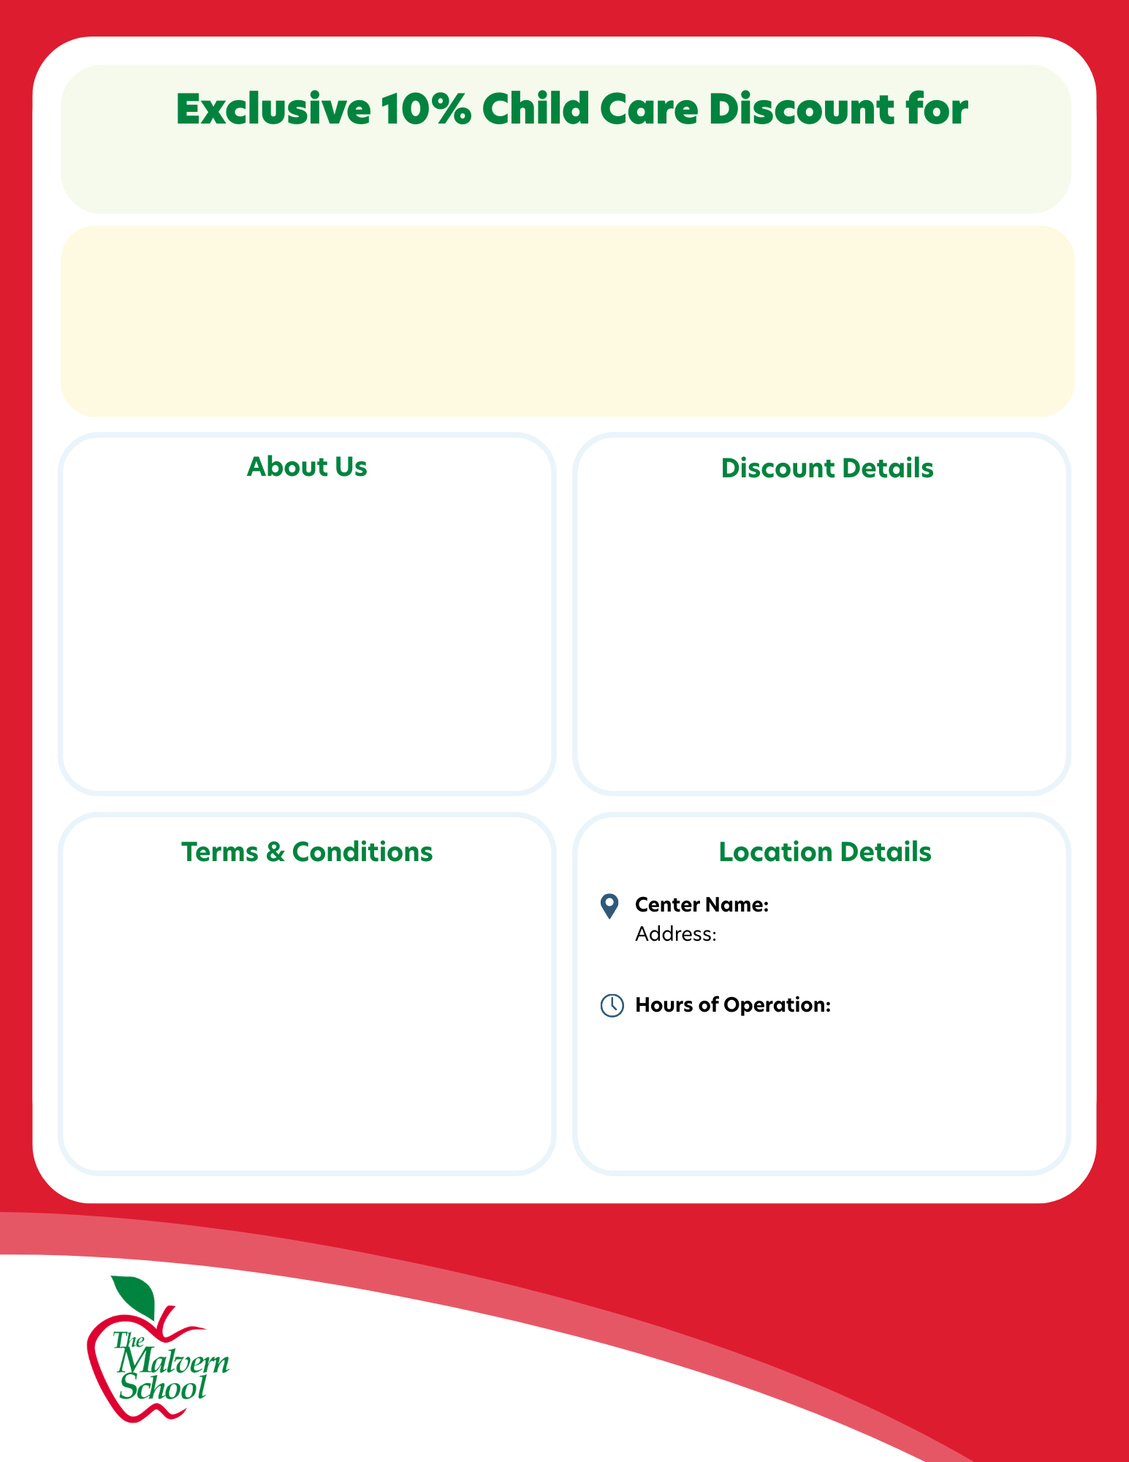
[Insert Company/Organization Name]
As a special perk through our corporate partnership with
[Insert Company/Organization Name], your family is eligible for an exclusive 10% discount on tuition at our top-rated child care centers!
Give your child a nurturing, educational environment that supports their growth and development – all while saving on tuition costs!
[Insert Center Name] provides high-quality child care, pre-K, and preschool
Engaging, play-based learning that supports cognitive, social, and physical growth
Caring, dedicated educators who truly know and nurture each child
Safe, modern, and welcoming spaces where children feel at home
Focused on building confidence, curiosity, and a lifelong love of learning
Parent must present their Center Director with proof of employment.
Discounts will take effect for the billing cycle immediately after the child care center receives proof of employment.
Corporate discounts will not be backdated.
One discount per child
Discount will activate on the date proof of employment is provided
Discounts will be audited annually to confirm continued proof of employment
Family must be an employee and not contracted

