Slide 2
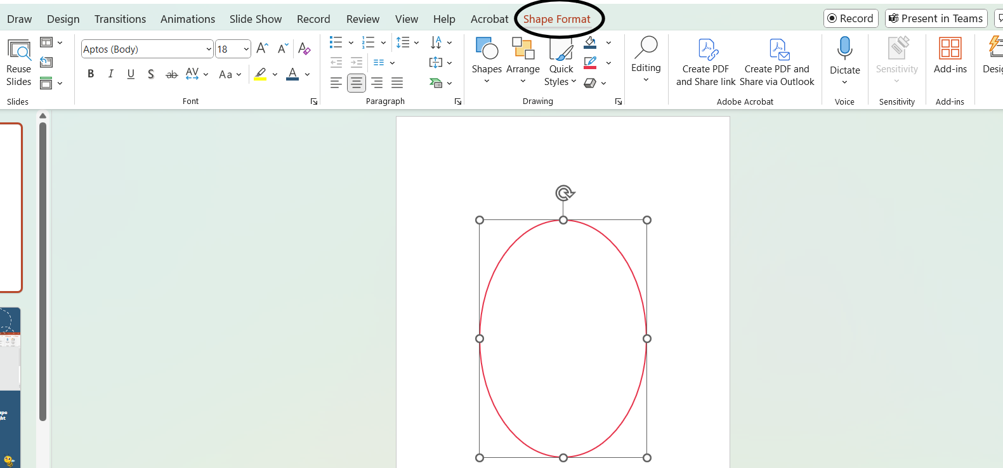

How to Insert Image
into Oval
Step 1:
Click on the oval and press the tab ‘Shape Format’ that will pop up on the top right corner.

Slide 3
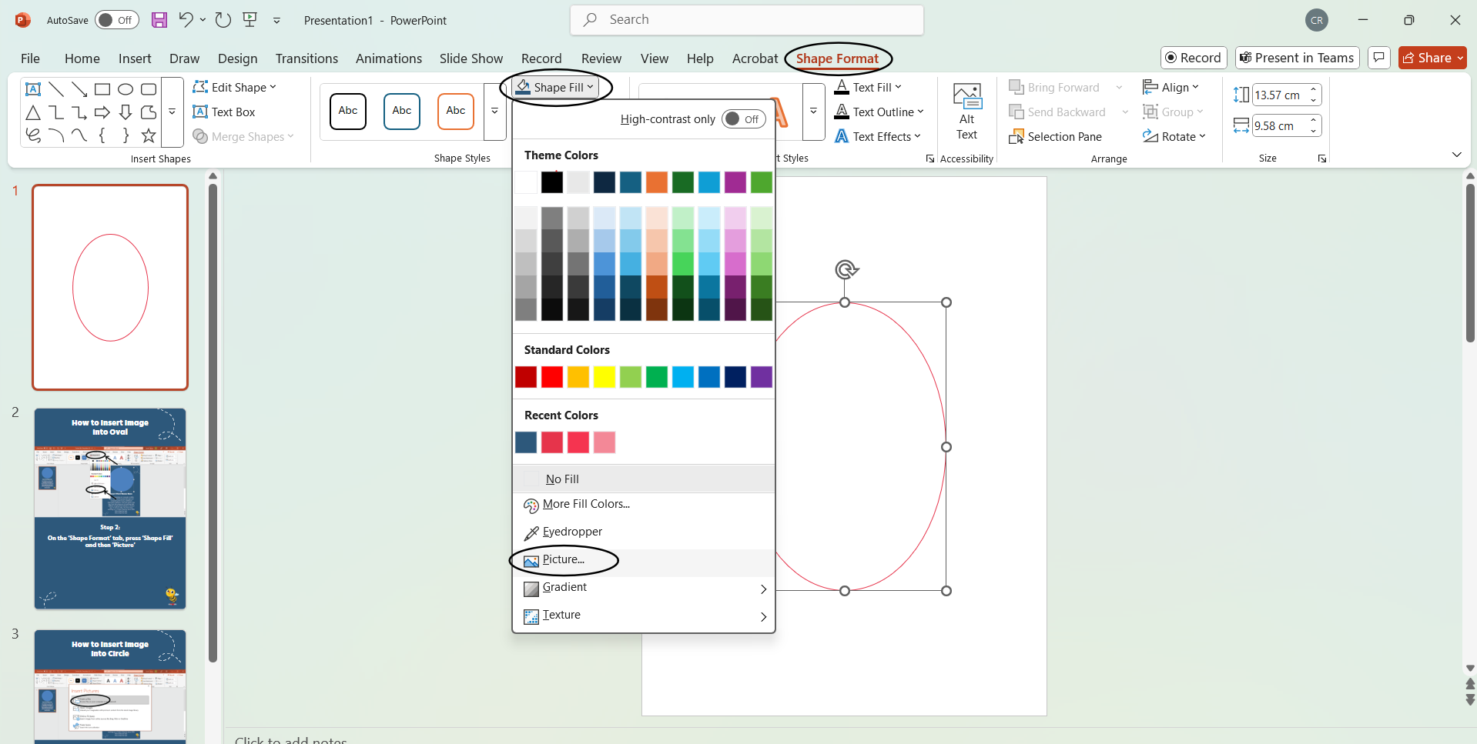
How to Insert Image
into Oval
Step 2:
On the ‘Shape Format’ tab, press ‘Shape Fill’ and then ‘Picture’

Slide 4
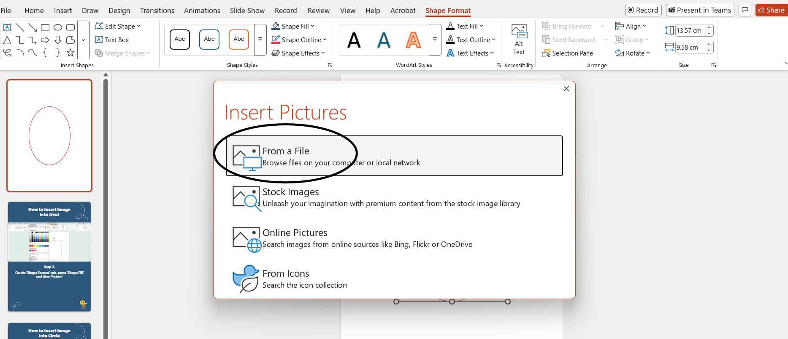
How to Insert Image
into Oval
Step 3:
This will prompt the following window to pop up. Press ‘From a File’ and choose the picture you’d like to attach!
Please make sure the original image is cropped into a vertical rectangle to maintain proportion within the oval – if not, it may be stretched or expanded!

