Slide 1
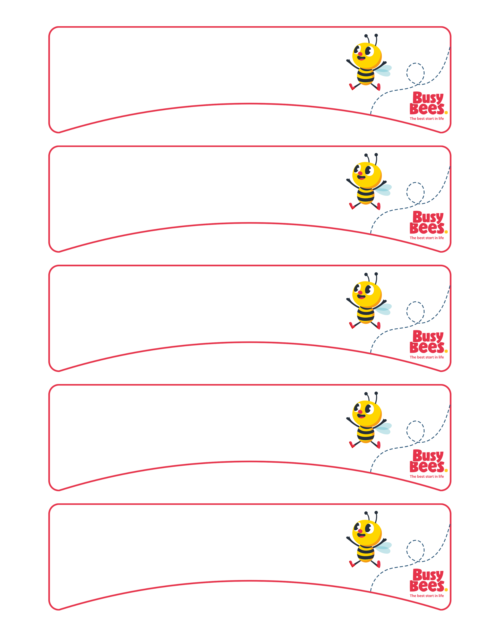
Insert Child First Name
Insert Child First Name
Insert Child First Name
Insert Child First Name
Insert Child First Name

Slide 2
Insert Photo
& delete text box
Insert Photo
& delete text box

