Slide 1
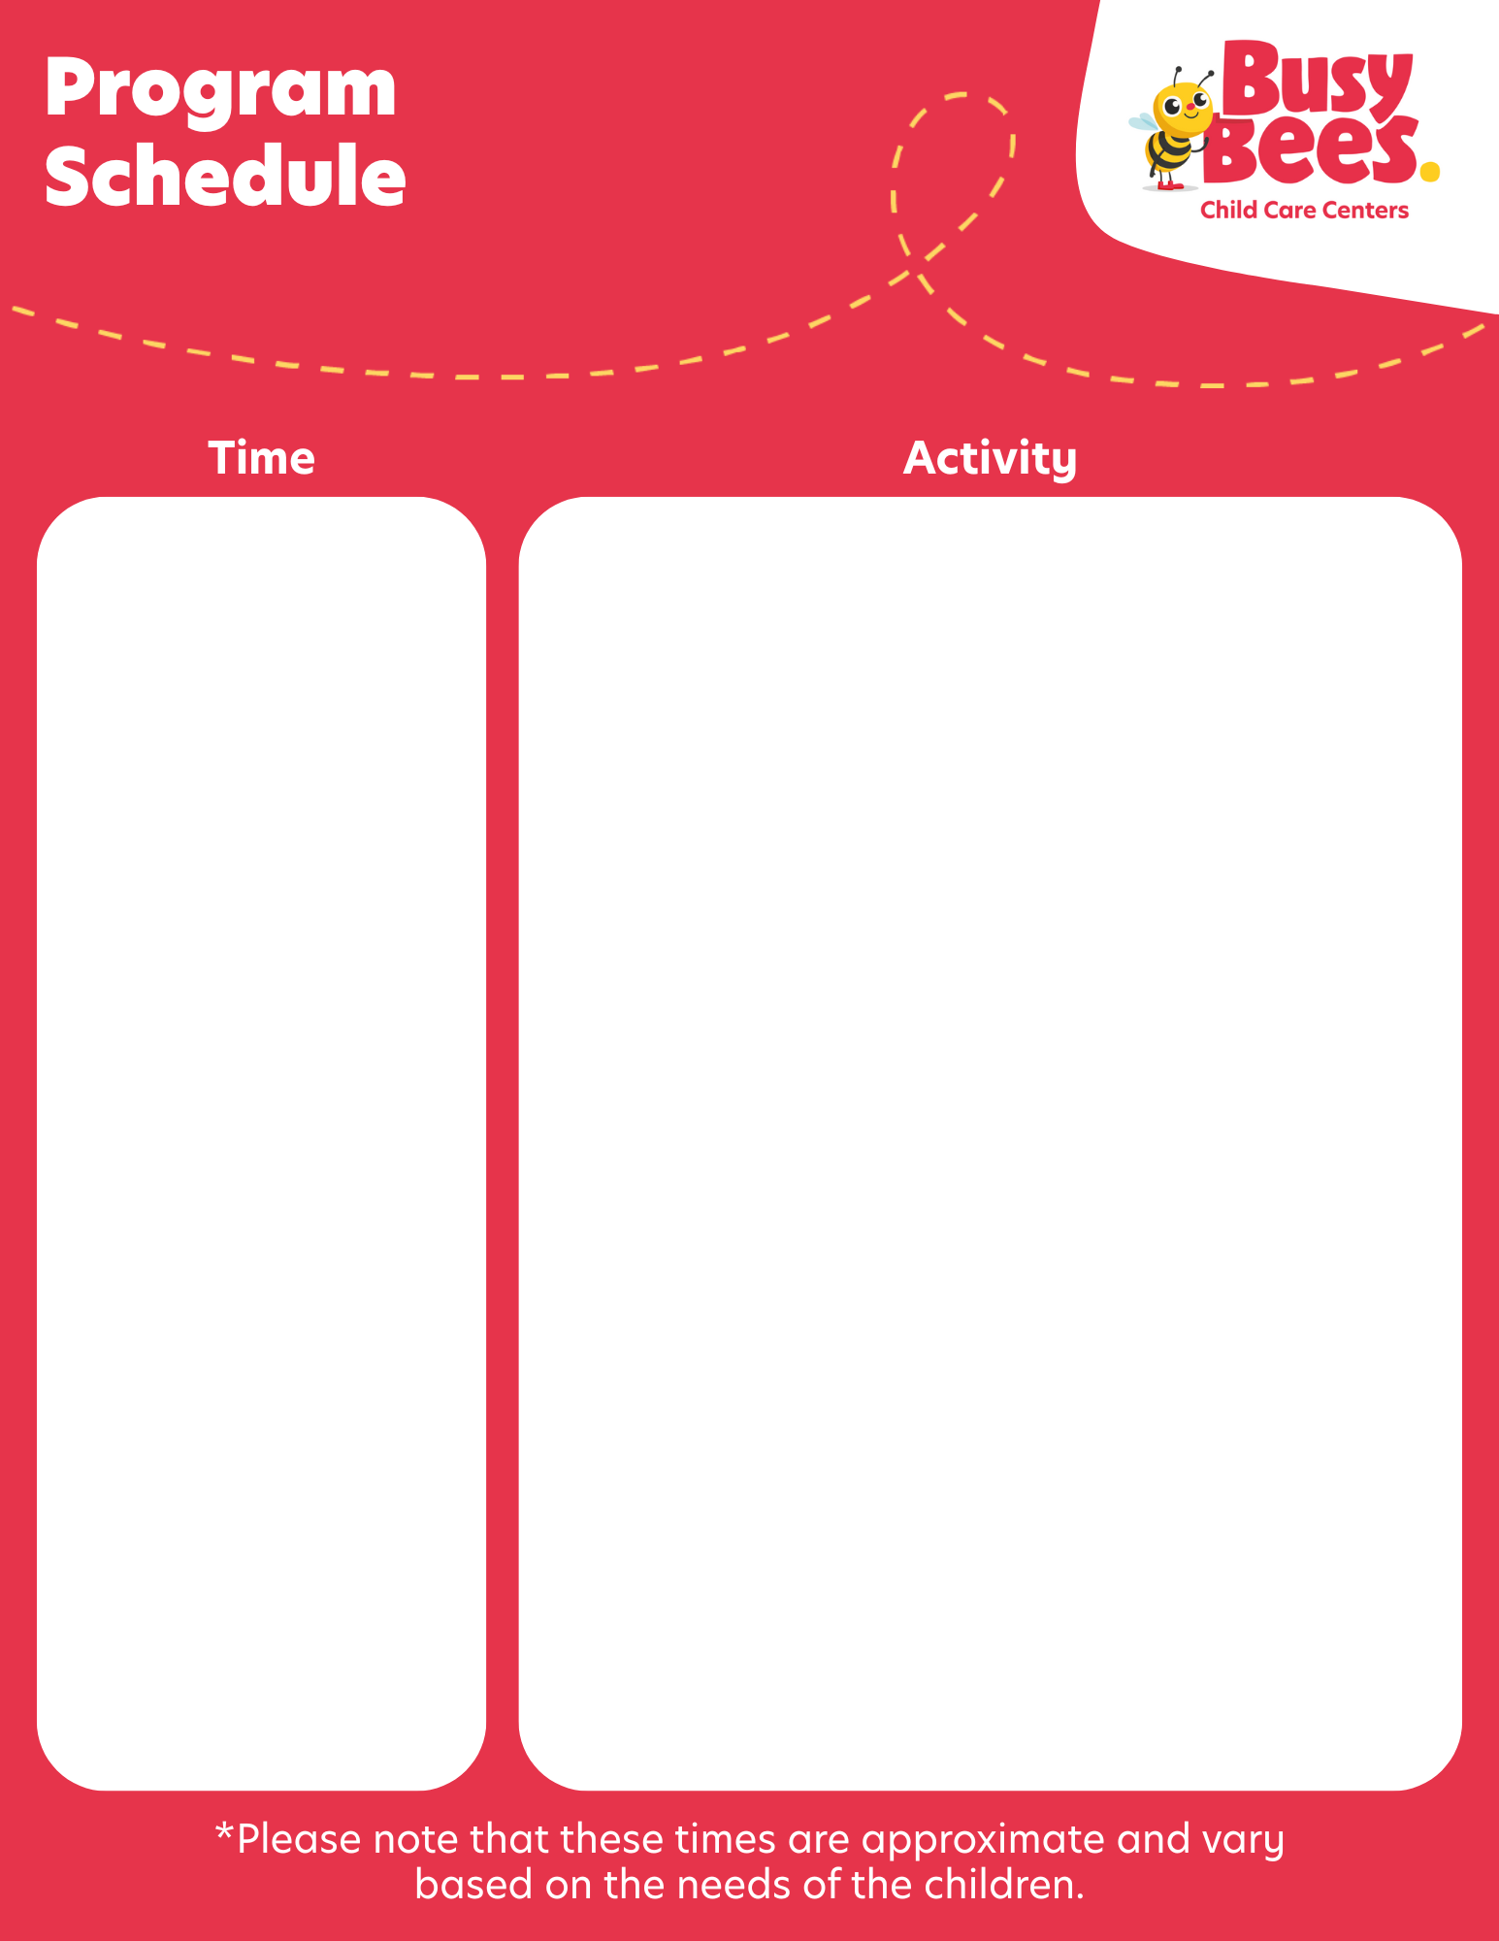
Preschool 1
6:00-7:30
Family Grouping
7:30-8:30
Open Learning Environment
8:30-9:15
Open Snack
9:15-9:30
Gathering Circle
9:30-10:45
BeeCurious Learning
10:45-11:45
Outdoor Engagement & Physical Literacy
11:45-12:45
Family Style Dining Lunch
12:45-2:15
Rest Time and Quiet Activities
2:15:3:00
Open Snack
3:00-3:15
Gathering Circle
3:15-4:15
BeeCurious Learning
4:15-5:00
Outdoor Engagement & Physical Literacy
5:00-5:30
Open Learning Environment
5:30-6:00
Family Grouping

