Slide 1
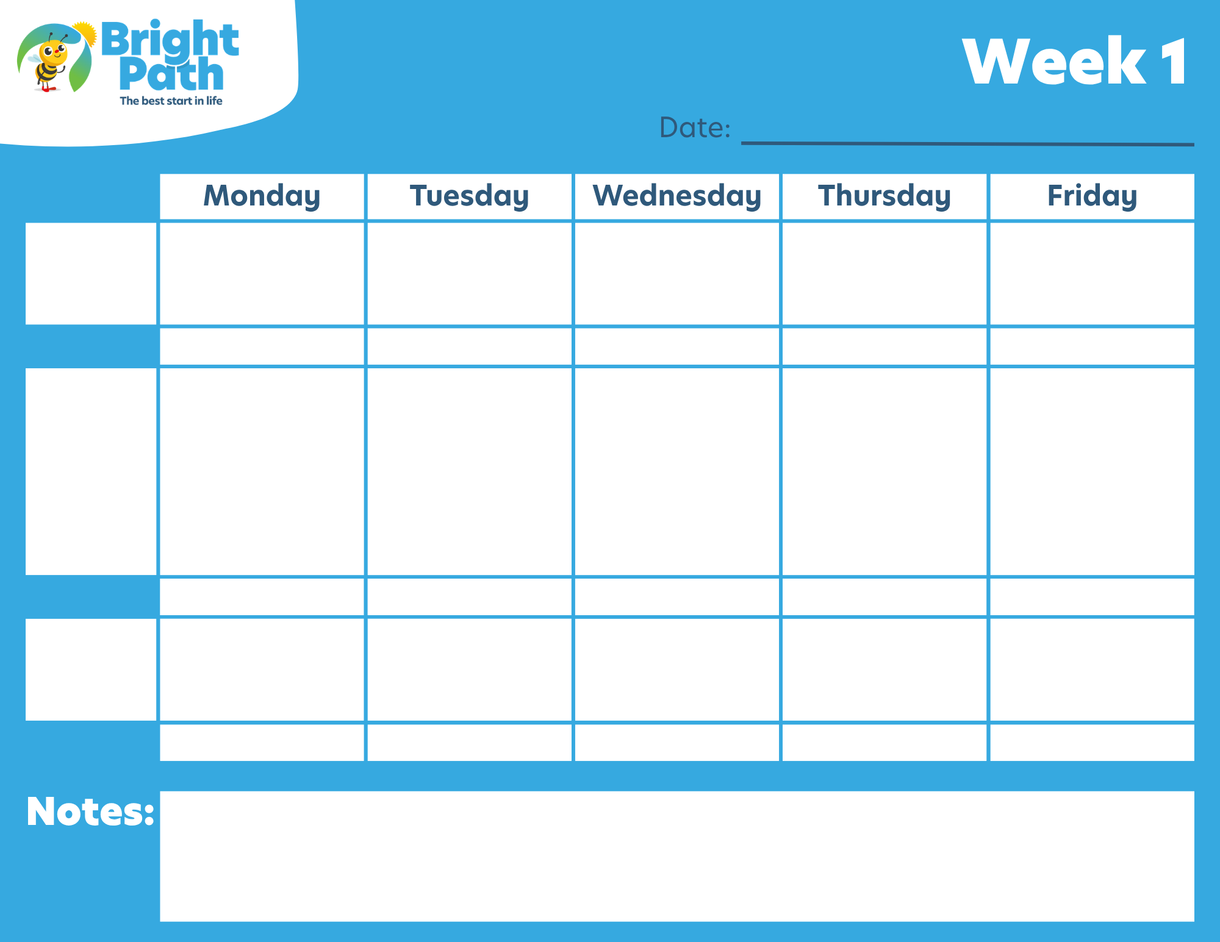
xx/xx/xxxx to xx/xx/xxxx
Food
Food
Food
Food
Food
Breakfast
Beverage
Beverage
Beverage
Beverage
Beverage
Food
Food
Food
Food
Food
Lunch
Beverage
Beverage
Beverage
Beverage
Beverage
PM Snack
Food
Food
Food
Items Food
Food
Beverage
Beverage
Beverage
Beverage
Beverage
1-2 Years
Milk ½ cup
Vegetable/Fruit ¼ cup
Grains/Breads ½ slice
Cooked Cereal ¼ cup
And/or pasta ¼ cup
3-5 Years
Milk ¾ cup
Vegetable/Fruit ¼ cup
Grains/Breads ½ slice
Cooked Cereal ¼ cup
And/or pasta ¼ cup
6+ Years
Milk 1 cup
Vegetable/Fruit ½ cup
Grains/Breads 1 slice
Cooked Cereal ½ cup
And/or pasta ½ cup
Other Notes:
Fresh fruit & water are available throughout the day.
Second servings are always allowed.
Cheese sticks are offered with every breakfast.

Slide 2

xx/xx/xxxx to xx/xx/xxxx
Food
Food
Food
Food
Food
Breakfast
Beverage
Beverage
Beverage
Beverage
Beverage
Food
Food
Food
Food
Food
Lunch
Beverage
Beverage
Beverage
Beverage
Beverage
PM Snack
Food
Food
Food
Items Food
Food
Beverage
Beverage
Beverage
Beverage
Beverage
1-2 Years
Milk ½ cup
Vegetable/Fruit ¼ cup
Grains/Breads ½ slice
Cooked Cereal ¼ cup
And/or pasta ¼ cup
3-5 Years
Milk ¾ cup
Vegetable/Fruit ¼ cup
Grains/Breads ½ slice
Cooked Cereal ¼ cup
And/or pasta ¼ cup
6+ Years
Milk 1 cup
Vegetable/Fruit ½ cup
Grains/Breads 1 slice
Cooked Cereal ½ cup
And/or pasta ½ cup
Other Notes:
Fresh fruit & water are available throughout the day.
Second servings are always allowed.
Cheese sticks are offered with every breakfast.

Slide 3

xx/xx/xxxx to xx/xx/xxxx
Food
Food
Food
Food
Food
Breakfast
Beverage
Beverage
Beverage
Beverage
Beverage
Food
Food
Food
Food
Food
Lunch
Beverage
Beverage
Beverage
Beverage
Beverage
PM Snack
Food
Food
Food
Items Food
Food
Beverage
Beverage
Beverage
Beverage
Beverage
1-2 Years
Milk ½ cup
Vegetable/Fruit ¼ cup
Grains/Breads ½ slice
Cooked Cereal ¼ cup
And/or pasta ¼ cup
3-5 Years
Milk ¾ cup
Vegetable/Fruit ¼ cup
Grains/Breads ½ slice
Cooked Cereal ¼ cup
And/or pasta ¼ cup
6+ Years
Milk 1 cup
Vegetable/Fruit ½ cup
Grains/Breads 1 slice
Cooked Cereal ½ cup
And/or pasta ½ cup
Other Notes:
Fresh fruit & water are available throughout the day.
Second servings are always allowed.
Cheese sticks are offered with every breakfast.

Slide 4

xx/xx/xxxx to xx/xx/xxxx
Food
Food
Food
Food
Food
Breakfast
Beverage
Beverage
Beverage
Beverage
Beverage
Food
Food
Food
Food
Food
Lunch
Beverage
Beverage
Beverage
Beverage
Beverage
PM Snack
Food
Food
Food
Items Food
Food
Beverage
Beverage
Beverage
Beverage
Beverage
1-2 Years
Milk ½ cup
Vegetable/Fruit ¼ cup
Grains/Breads ½ slice
Cooked Cereal ¼ cup
And/or pasta ¼ cup
3-5 Years
Milk ¾ cup
Vegetable/Fruit ¼ cup
Grains/Breads ½ slice
Cooked Cereal ¼ cup
And/or pasta ¼ cup
6+ Years
Milk 1 cup
Vegetable/Fruit ½ cup
Grains/Breads 1 slice
Cooked Cereal ½ cup
And/or pasta ½ cup
Other Notes:
Fresh fruit & water are available throughout the day.
Second servings are always allowed.
Cheese sticks are offered with every breakfast.

